Slide 1




DE15 Report Presentation
George
Kate
Joao
Ross
Chris

Slide 2
Intent of our report
Impact of Covid on hospitalizations
Impact of Covid on demographics
General trend of consequent admissions
Representation in Shiny dashboard

Slide 3
Hospitalisations

Slide 4
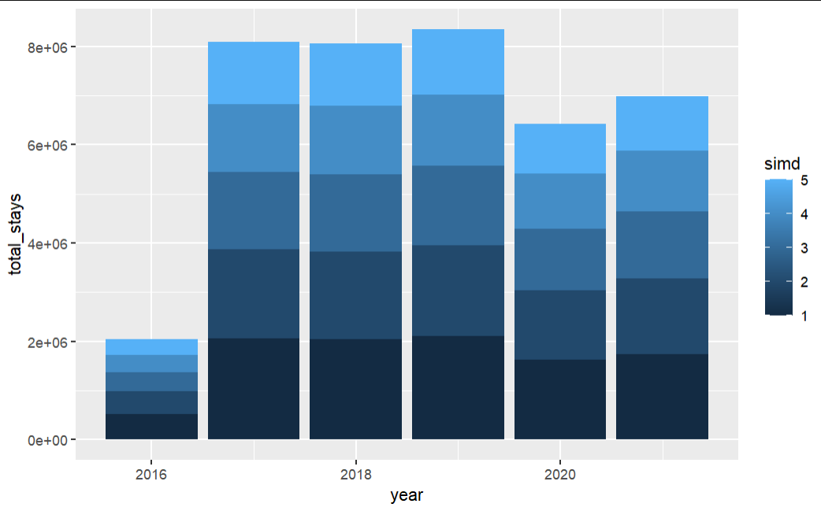
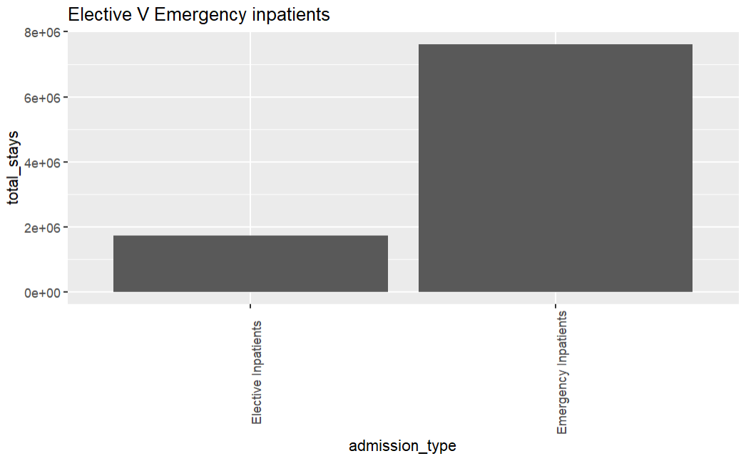
Impact on Demographics

Slide 5
Map of Impact

Slide 6
Temporal data

Slide 7
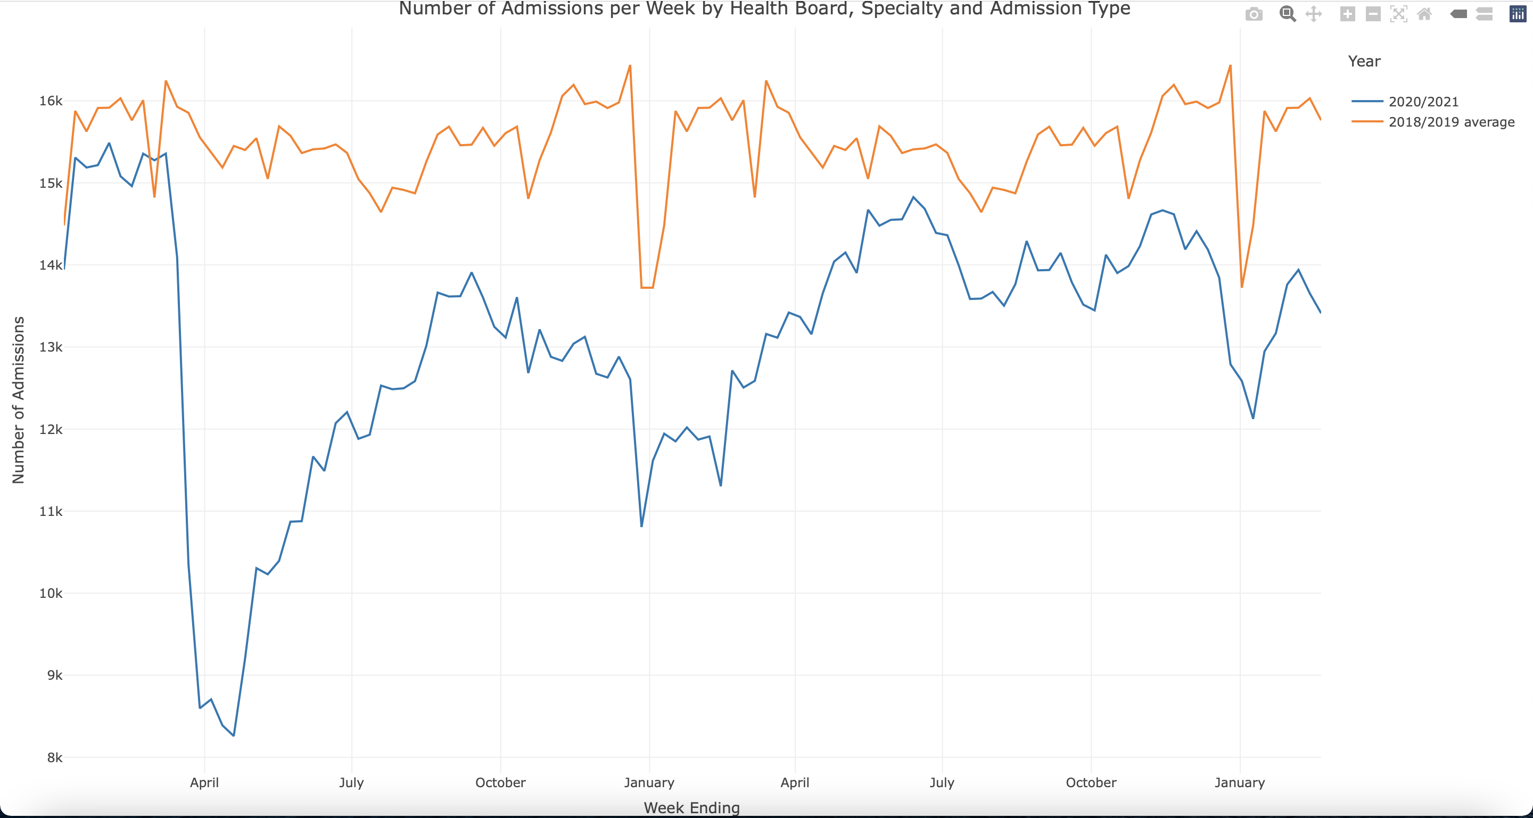
Trend of Admissions

Slide 8
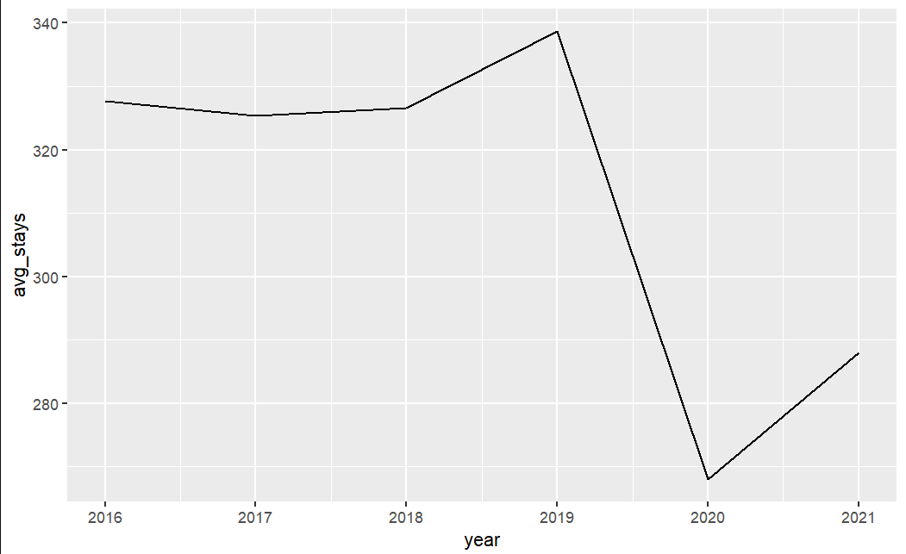
Trend of stays

Slide 9
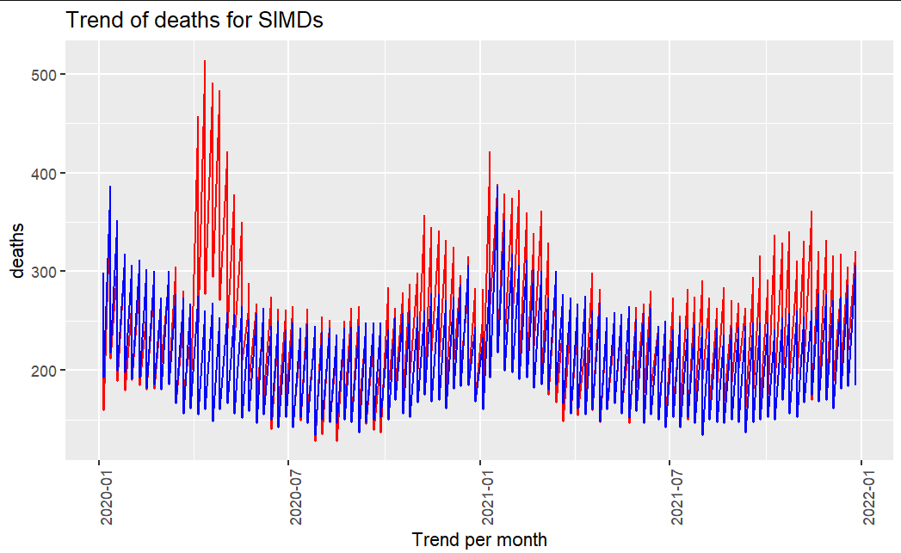
Trend of deaths
Average death trend from 2015 to 2019
Average death trend from January 2020 onwards

Slide 10
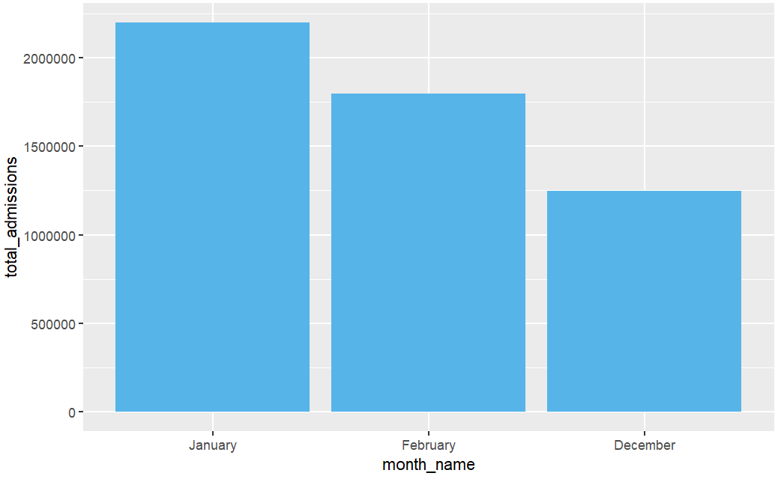
Impact of Winter

Slide 11
Shiny Dashboard

Slide 12
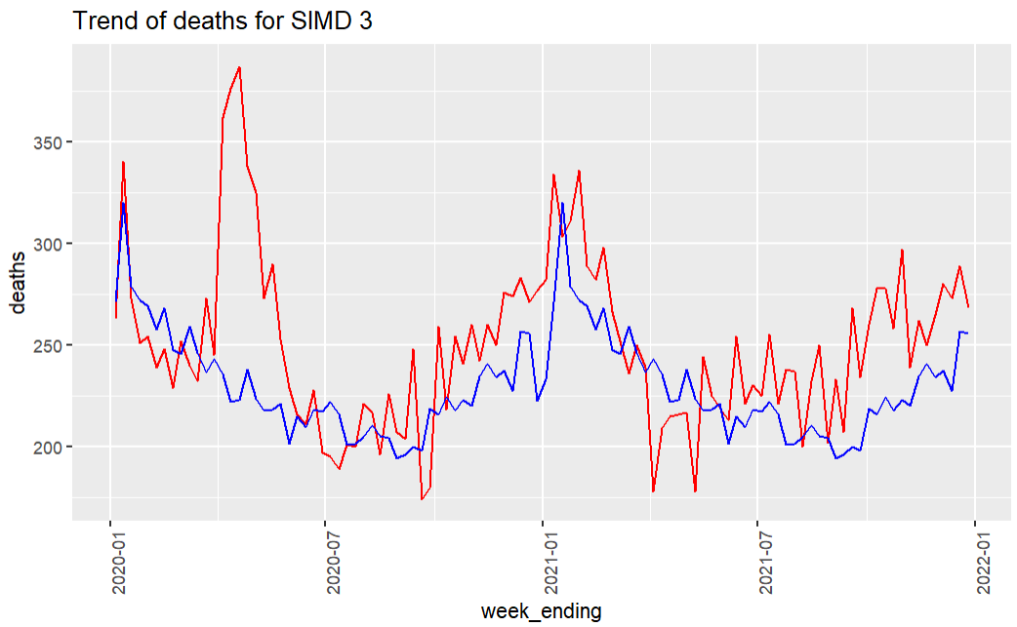
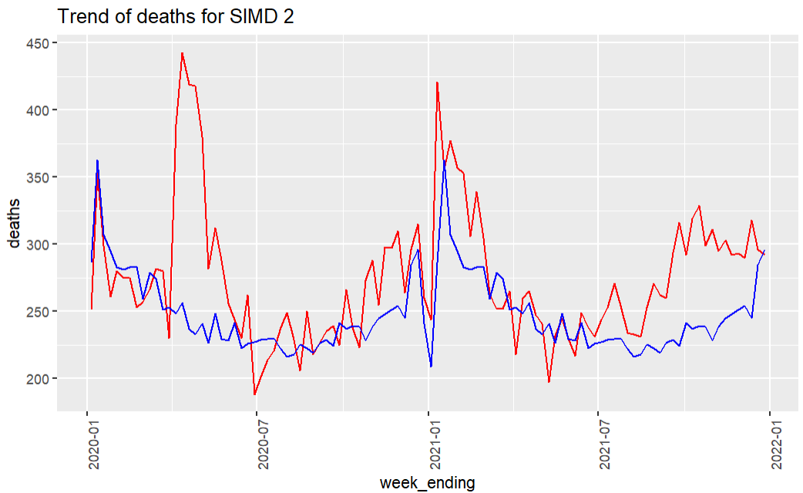
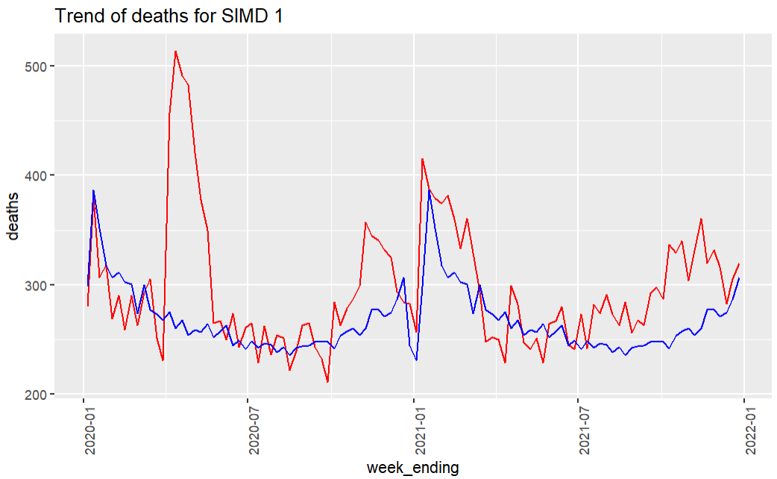
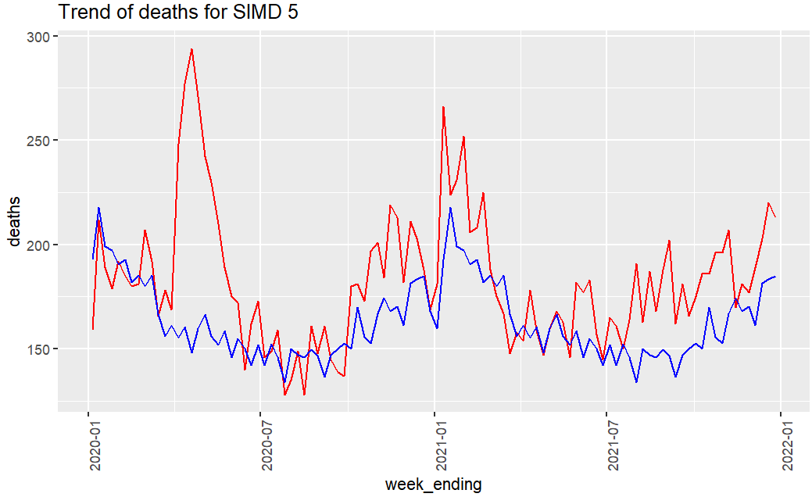
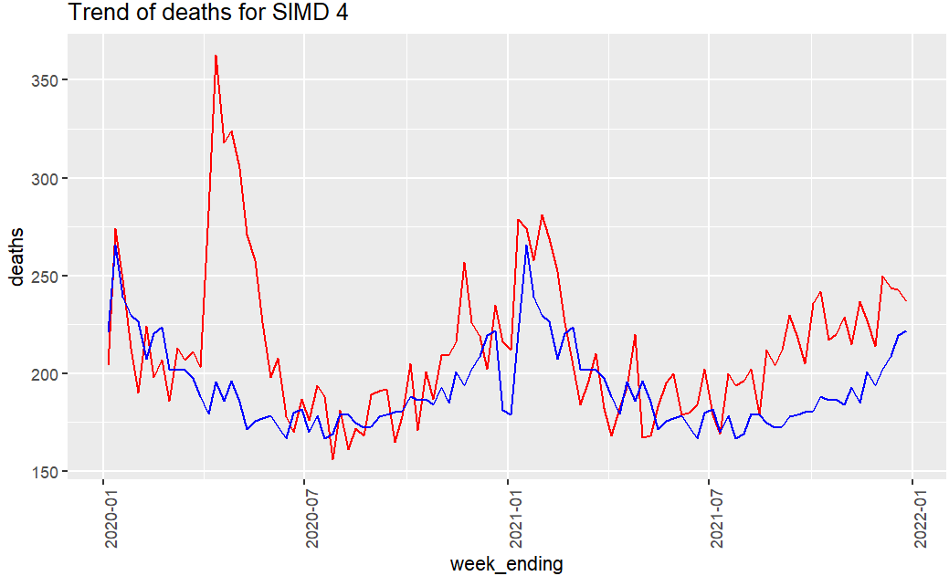

Deprivation

